Slide 1
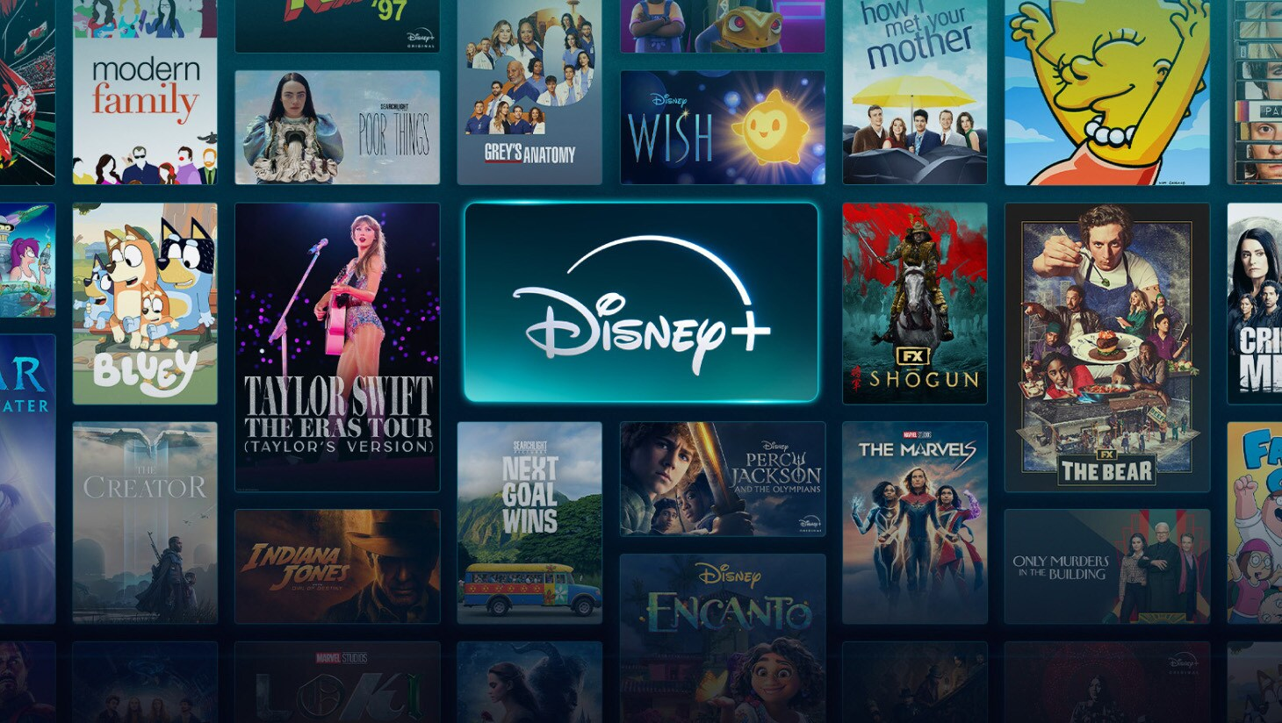
Welcome to Disney+ Movie Database
Presented by :
Siddatha Nanuvala
Shreeram Balaram
Abbas Tohme
Syed Mohammad shah mostafa

Slide 2

Introduction
Content:
The Disney+ Themed Movie Database is a dynamic application designed to:
Query Disney movies efficiently.
Display search results using a user-friendly GUI.
Enable customized searches by integrating Python, Oracle SQL, and PyQt5.

Slide 3

Problem Statement
Content:
Manual Search Limitations:
Searching movie data manually is time-consuming and inefficient.
Hard to retrieve filtered information such as top-rated movies or movies by a specific actor.
Objective:
Build a responsive application to query and display Disney movie data efficiently.

Slide 4
Objectives
Content:
Design and develop a structured movie database using Oracle SQL.
Integrate the database with a PyQt5-based GUI in Python.
Provide search capabilities:
By movie name, year, actor, or director.
Implement a visually appealing, Disney+ themed interface.

Slide 5

Tools & Technologies
Content:
Database Management: Oracle SQL Developer
Programming Language: Python
GUI Library: PyQt5
Database Connectivity: cx_Oracle
Development Environment: Visual Studio Code

Slide 6
Database Schema
Tables Overview
Movies Table (Parent Table)
Directors Table
Actors Table
Genres Table
Movie_Actors Table (Junction Table for Many-to-Many Relationships)
Movie_Genres Table (Junction Table for Movies and Genres)
Production_Countries Table

Slide 7
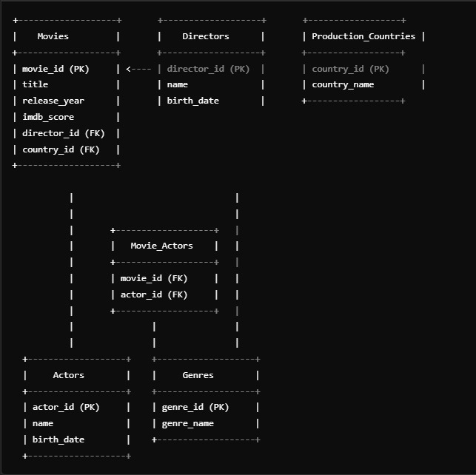
Relationships:
Movies Table:
director_id → Directors Table (director_id) → One-to-Many relationship (One director can direct multiple movies).
country_id → Production_Countries Table (country_id) → One-to-Many relationship.
Actors and Movies:
Linked using Movie_Actors Table → Many-to-Many relationship.
Genres and Movies:
Linked using Movie_Genres Table → Many-to-Many relationship.

Slide 8

System Architecture
User Input: Search bar, dropdown queries.
Query Processing: Python sends SQL queries to Oracle.
Database: Oracle SQL retrieves the requested data.
Results Display: Output is displayed in a PyQt5 Table widget.
Flow chart:
User → Python Query → Oracle SQL → Results → GUI Display

Slide 9
GUI Design
Content:
Describe the user interface:
Search Bar: Input for movie queries.
Query Dropdown: Predefined query options (e.g., Show All Movies).
Buttons: Search, Run Query, Clear Table, Exit.
Table Display: Results appear here.
Background: Disney+ theme with a collage.
Key Features:
Search Functionality:
Search by movie name, year, actor, or director.
Predefined Queries:
Show All Movies.
High-Rated Movies (IMDb > 9).
Recently Added Movies.
Interactive GUI:
Attractive Disney+ theme with intuitive design.
Efficient Results Display:
Tabular format for clarity.

Slide 10
Challenges & Solutions
Challenge: UI Responsiveness for full-screen view.
Solution: Used scaling techniques to dynamically fit the window size.
Challenge: Database Connectivity Issues.
Solution: Implemented cx_Oracle for efficient connection and query execution.
Results
Successfully implemented the Disney+ Themed Movie Database:
Interactive GUI for querying Disney movie data.
Real-time database queries displayed in a clean table format.
User-friendly design with Disney+ themed visuals.

Slide 11
Conclusion
Gained hands-on experience in:
Database Design using Oracle SQL.
GUI Development using PyQt5.
Integration of Python with Oracle.
Future Scope:
Add more advanced queries like genre-based search.
Include movie posters and trailers.
Enhance UI with more animations.

Slide 12

Thank you
Any questions ?

